Slide 1
How to use XAKA SDK
XANDAR KARIDAN

Slide 2
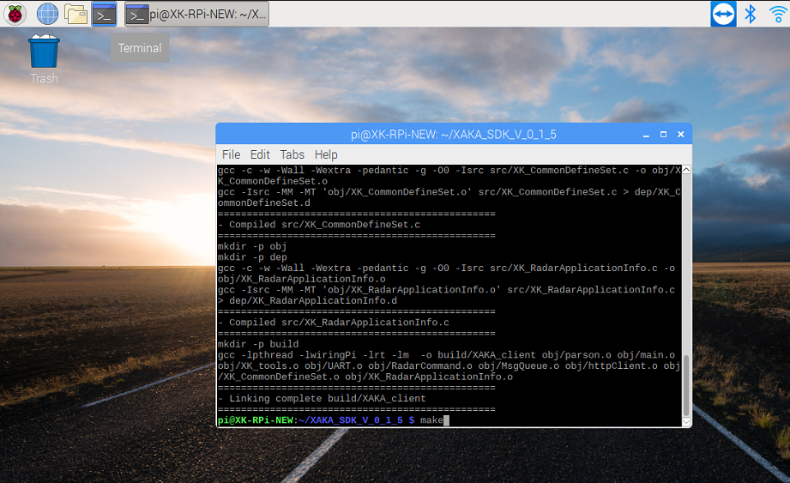

Build Xandar Kardian SDK
Run the terminal
Enter to build XAKA SDK:
- Clean project
$ make clean
- Build SDK
$ make
※ If you get an error as shown below…
Execute the attached file in the project.
$ sudo chmod 777 install_libcurl.sh
$ ./install_libcurl.sh

Slide 3
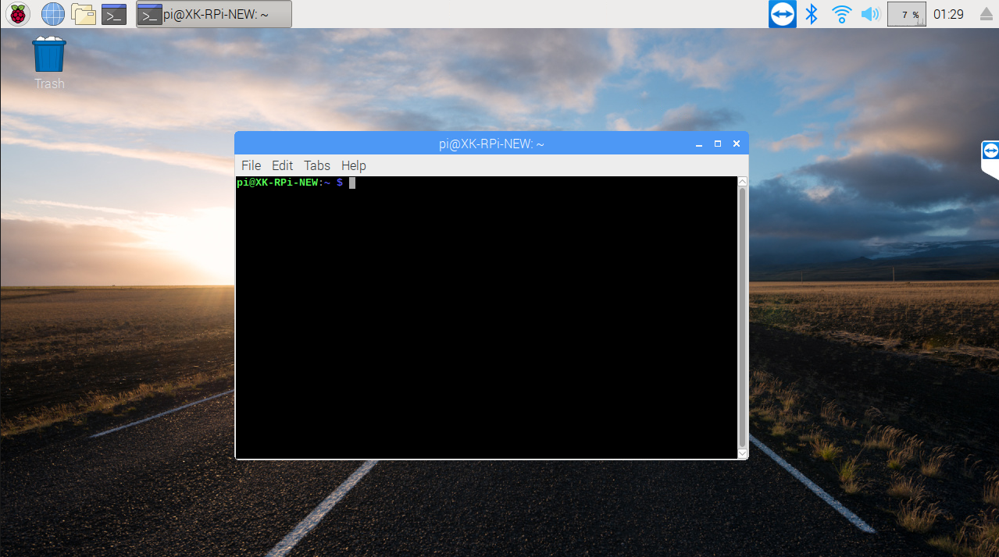
Run Xandar Kardian SDK
Run the terminal
Enter to Run XAKA SDK:
- Change directory
$ cd XAKA_SDK_(VERSION)
- Run SDK
$ build/XAKA_client (option)
Options
-h: display help
-s: display sending message
-r: display receiving message

Slide 4
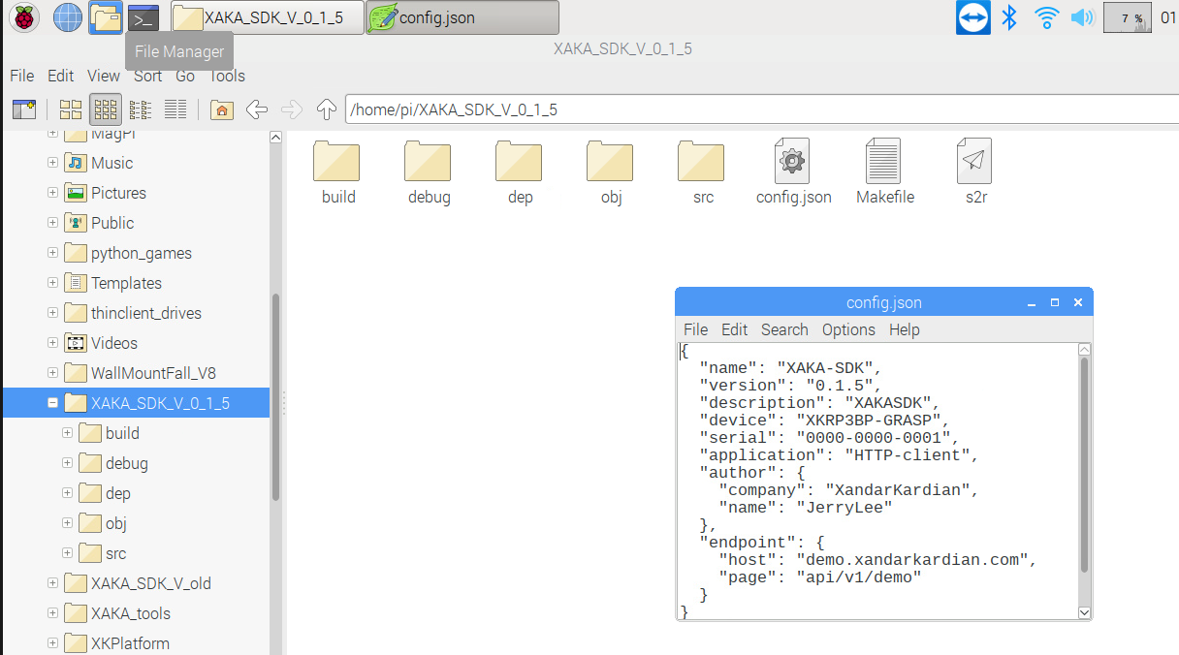
Change configuration
Open XAKA_SDK path
Open ‘config.json’ file
Change configuration
object
- name: SDK’s name
- version: SDK’s version
- device: Client device name
- application: The device’s application
- endpoint: The server that wants to
transmit the radar data finally
- host: Address except ‘http://’ * It can also be an IP address.
- page: Address except host

